Slide 1
Intro to Cloud Computing CS4037 (BCS-6A) Lecture 15
Dept. of Computer Science
FAST School of Computing
NUCES Lahore

Slide 2
Module 8: Databases
AWS Academy Cloud Foundations

Slide 3

Module overview
Topics
Amazon Relational Database Service (Amazon RDS)
Amazon DynamoDB
Amazon Redshift
Amazon Aurora
Demos
Amazon RDS console
Amazon DynamoDB console
Lab
Lab 5: Build Your DB Server and Interact with Your DB Using an App
Activity
Database case studies
Knowledge check

Slide 4
Module objectives
After completing this module, you should be able to:
Explain Amazon Relational Database Service (Amazon RDS)
Identify the functionality in Amazon RDS
Explain Amazon DynamoDB
Identify the functionality in Amazon DynamoDB
Explain Amazon Redshift
Explain Amazon Aurora
Perform tasks in an RDS database, such as launching, configuring, and interacting

Slide 5
Section 1: Amazon Relational Database Service
Module 8: Databases

Slide 6
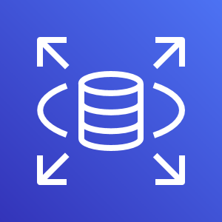
Amazon Relational Database Service
Amazon Relational Database Service (Amazon RDS)

Slide 7

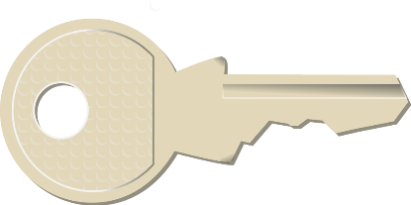


Unmanaged versus managed services
Unmanaged:
Managed:
Scaling, fault tolerance, and availability are managed by you.
Scaling, fault tolerance, and availability are typically built into the service.

Slide 8
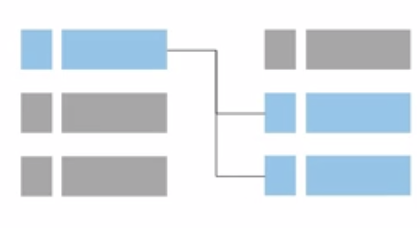
Challenges of unmanaged relational databases
Server maintenance and energy footprint
Software installation and patches
Database backups and high availability
Limits on scalability
Data security
Operating system (OS) installation and patches

Slide 9



Amazon RDS
Managed service that sets up and operates a relational database in the cloud.
AWS Cloud
Users
Application
Servers
Amazon RDS

Slide 10

From on-premises databases to Amazon RDS
Database in Amazon Elastic Compute Cloud (Amazon EC2)
Database in Amazon RDS or Amazon Aurora
On-premises database
Application optimization
Scaling
High Availability
Database backups
Database software patches
Database software installs
Operation system patches
Operating system install
Server maintenance
Rack and stack servers
Power, HVAC, network
Application optimization
Scaling
High Availability
Database backups
Database software patches
Database software installs
Operation system patches
Operating system install
Server maintenance
Rack and stack servers
Power, HVAC, network
Application optimization
Scaling
High Availability
Database backups
Database software patches
Database software installs
Operation system patches
Operating system install
Server maintenance
Rack and stack servers
Power, HVAC, network
AWS
provides
AWS
provides

Slide 11

Managed services responsibilities
You manage:
Application optimization
AWS manages:
OS installation and patches
Database software installation and patches
Database backups
High availability
Scaling
Power and racking and stacking servers
Server maintenance
Amazon RDS

Slide 12
Amazon RDS DB instances
Amazon RDS
=
MySQL
DB Instance Class
CPU
Memory
Network performance
DB Instance Storage
Magnetic
General Purpose (solid state drive, or SSD)
Provisioned IOPS
Amazon Aurora
M
Microsoft SQL Server
PostgreSQL
Amazon RDS DB main instance
MariaDB
Oracle
DB engines

Slide 13





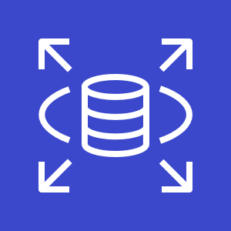
Amazon RDS in a virtual private cloud (VPC)
AWS Cloud
Availability Zone
VPC
Public subnet
Internet gateway
Users
Amazon EC2
Private subnet
Amazon RDS

Slide 14
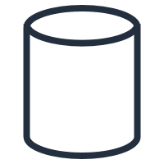
High availability with Multi-AZ deployment (1 of 2)
AWS Cloud
Availability Zone 1
Availability Zone 2
VPC
Public subnet
Amazon EC2
Application
Private subnet
Private subnet
M
Synchronous
S
Amazon RDS
instance
RDS Standby
instance

Slide 15
High availability with Multi-AZ deployment (2 of 2)
AWS Cloud
Availability Zone 1
Availability Zone 2
VPC
Public subnet
Amazon EC2
Application
Private subnet
Private subnet
M
Synchronous
S
Amazon RDS
instance
RDS Standby
instance

Slide 16
Amazon RDS read replicas
Features & Functionality
Offers asynchronous replication
MySQL, MariaDB, PostgreSQL, and Aurora
Updates that are made to the source database instance are asynchronously copied to the read replica instance.
You can reduce the load on your source database instance by routing read queries from your applications to the read replica.
Can be promoted to primary if needed.
Can be created in a different Region than the primary database
Use for read-heavy database workloads
AWS Cloud
Availability Zone
VPC
Public subnet
Amazon EC2
Application
Private subnet
P
R
Amazon RDS
primary instance
Read replica
instance

Slide 17
Use cases
Web and mobile applications | High throughput Massive storage scalability High availability
Ecommerce applications | Low-cost database Data security Fully managed solution
Mobile and online games | Rapidly grow capacity Automatic scaling Database monitoring

Slide 18
When to Use Amazon RDS
Use Amazon RDS when your application requires:
Do not use Amazon RDS when your application requires:
Complex transactions or complex queries
A medium to high query or write rate – Up to 30,000 IOPS (15,000 reads + 15,000 writes)
No more than a single worker node
High durability
Massive read/write rates (for example, 150,000 write/second)
High data size or throughput demands
Simple GET or PUT requests and queries that a database can handleNoSQL
Relational database management system (RDBMS) customization

Slide 19
Amazon RDS: Clock-hour billing and database characteristics
Clock-hour billing –
Resources incur charges when running
Database characteristics –
Physical capacity of database:
Engine
Size
Memory class

Slide 20
Amazon RDS: DB purchase type and multiple DB instances
DB purchase type –
On-Demand Instances
Compute capacity by the hour
Reserved Instances
Low, one-time, upfront payment for database instances that are reserved with a 1-year or 3-year term
Number of DB instances –
Provision multiple DB instances to handle peak loads

Slide 21
Amazon RDS: Storage
Provisioned storage –
No charge
Backup storage of up to 100 percent of database storage for an active database
Charge (GB/month)
Backup storage for terminated DB instances
Additional storage –
Charge (GB/month)
Backup storage in addition to provisioned storage

Slide 22
Amazon RDS: Deployment type and data transfer
Requests –
The number of input and output requests that are made to the database
Deployment type—Storage and I/0 charges vary, depending on whether you deploy to –
Single Availability Zone
Multiple Availability Zones
Data transfer –
No charge for inbound data transfer
Tiered charges for outbound data transfer

Slide 23
Recorded demo: Amazon RDS console

Slide 24

Build Your DB Server and Interact with Your DB Using an App

Slide 25
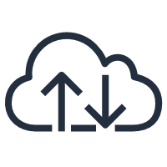


Lab 5: Scenario
This lab is designed to show you how to use an AWS managed database instance to solve a need for a relational database.
AWS Cloud
Availability Zone A
Availability Zone B
VPC: 10.0.0.0/16
Public subnet 1: 10.0.0.0/24
Public subnet 2: 10.0.2.0/24
Internet
Security group
Internet gateway
NAT
gateway
Web
Server
Private subnet 1:
10.0.1.0/24
Private subnet 2:
10.0.3.0/24

Slide 26
Lab 5: Tasks
Security group
Create a VPC security group.
Create a DB subnet group.
Create an Amazon RDS DB instance and interact with your database.
Private subnet
Amazon RDS

Slide 27
Lab 5: Final product
AWS Cloud
Availability Zone A
Availability Zone B
VPC: 10.0.0.0/16
Public subnet 1: 10.0.1.0/24
Public subnet 2: 10.0.2.0/24
Internet
Security group
NAT
gateway
Web
Server
Internet gateway
Private subnet 1:
10.0.3.0/24
Private subnet 2:
10.0.4.0/24
Security group
Security group
RDS DB
Primary
RDS DB Secondary

Slide 28

Section 1 key takeaways
With Amazon RDS, you can set up, operate, and scale relational databases in the cloud.
Features
Managed service
Accessible via the console, AWS Command Line Interface (AWS CLI), or application programming interface (API) calls
Scalable (compute and storage)
Automated redundancy and backup are available
Supported database engines:
Amazon Aurora, PostgreSQL, MySQL, MariaDB, Oracle, Microsoft SQL Server

Slide 29
Thank you
All trademarks are the property of their owners.

